Slide 1
Understanding Hotel Bookings: Insights from Data Analysis
Data Science Bootcamp 2023

Slide 2
AGENDA
Introduction
Cancellation Analysis
Factor Influencing Cancellation
Predictions
Summary

Slide 3
Introduction

Slide 4
INTRODUCTION
In this project, we aim to build a predictive model to determine whether a hotel booking would be canceled, which is crucial for hotels as cancellations affect revenue and operational planning.
We want also to determine the main factors that result into a cancellation.
Notes:
WHY?

Slide 5
CANCELLATION Analysis

Slide 6
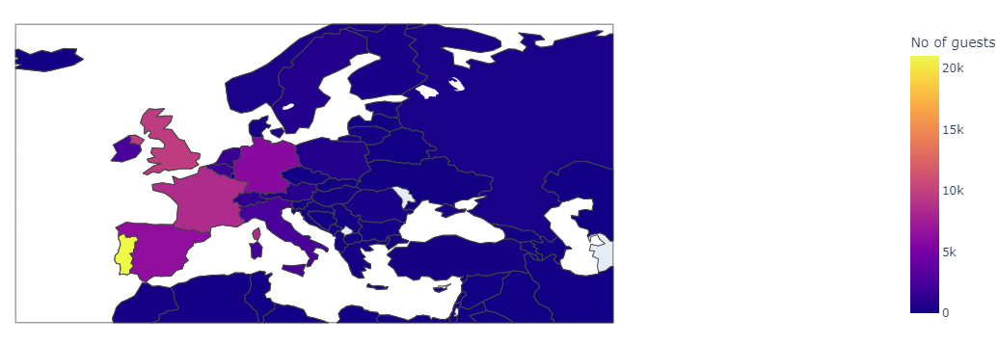
Bookings per country

Slide 7
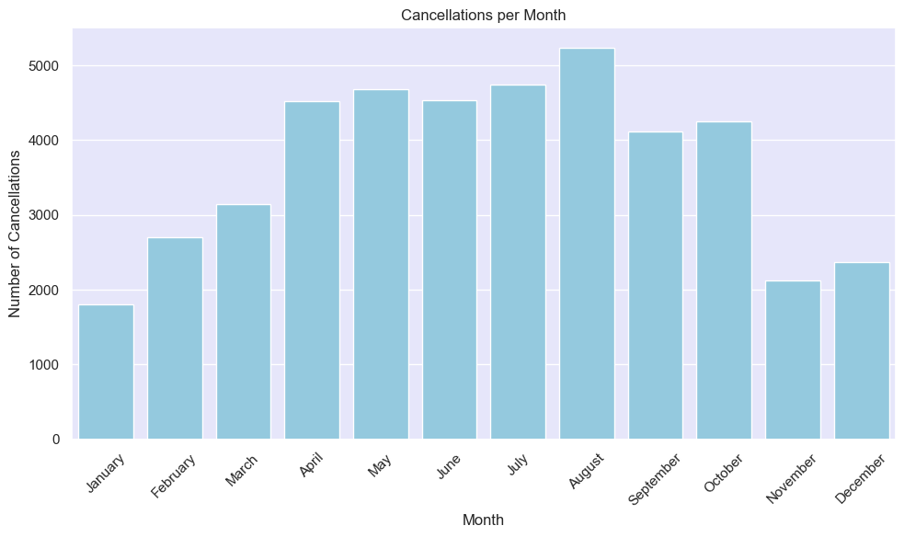
Cancellations per month

Slide 8
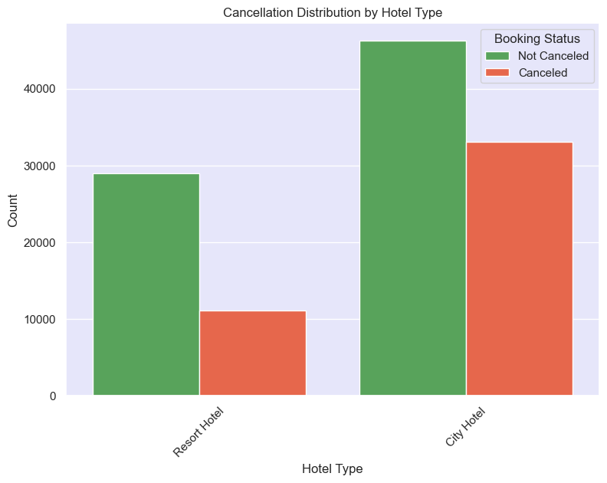
Cancellations per Hotel type

Slide 9
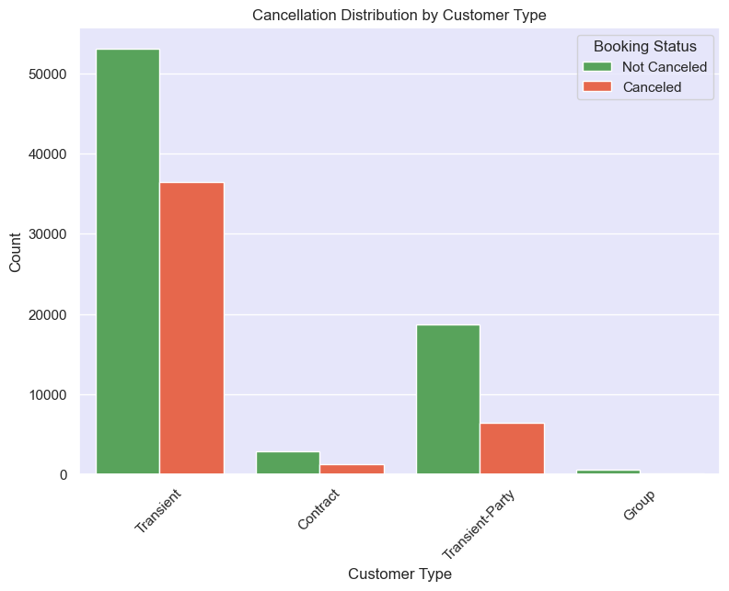
Cancellations per customer type

Slide 10
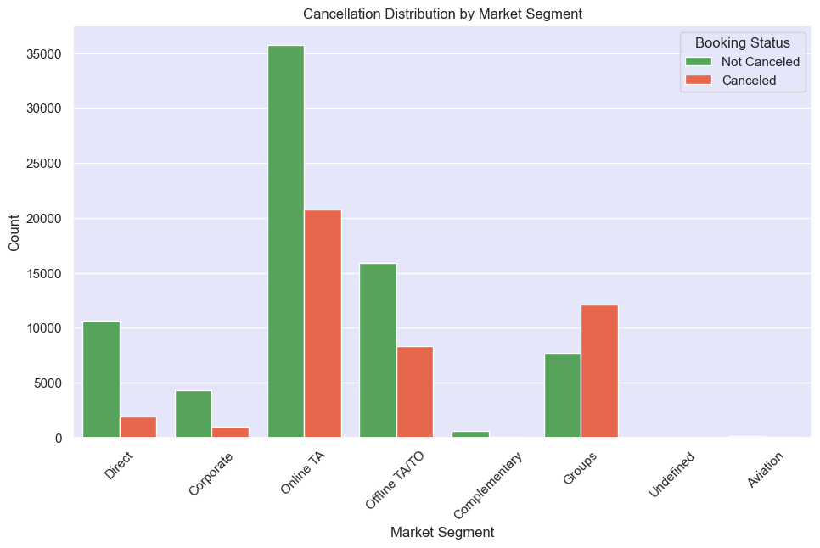
Cancellations per segment type

Slide 11
FACTORS INFLUENCING CANCELLATION

Slide 12
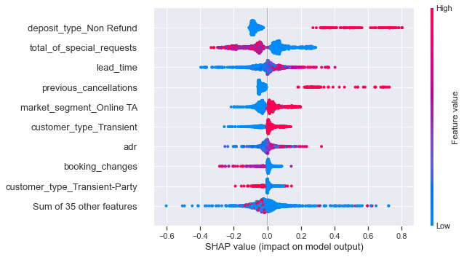
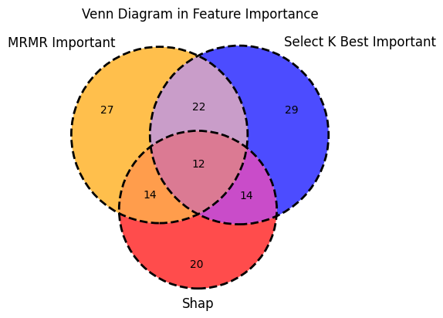
FACTORS INFLUENCING CANCELLATION
Average Daily Rate
Number of adults
Number of changes made to the booking
Type of customer : Transient-Party
Type of deposit made : Non Refund
Booking distribution channel : TA/TO
Hotel: Resort Hotel Market
Segment: Groups
Number of previous bookings that were canceled by the customer
Number of car parking spaces required
Number of special requests made

Slide 13
PREDICTIONS

Slide 14
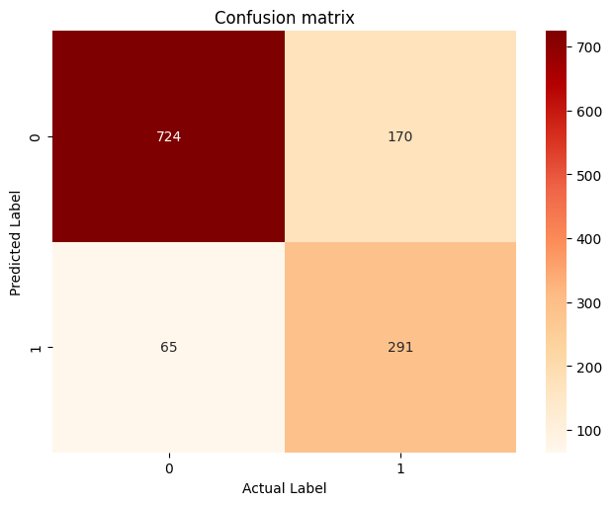
PREDICTIVE MODEL Accuracy
We created a model that predicts the cancellation of a hotel booking with 79% accuracy.

Slide 15
Summary

Slide 16
Highlights
Most Cancellations Occur During Summer, City Hotels,
Transient Customers, and Online TA Markets
2. Predicting Cancellations with high accuracy will optimize
operational planning and increase profits
3. Non-refundable deposit should be increased for Groups and Transient Parties
4. Our predictive model has 79% accuracy.

Slide 17

THANK YOU
Giannis Panagiotopoulos
Stavros Xakis
Stefanos Dimopoulos
Fotis Karamplias

